Slide 1
Node Js

Slide 2
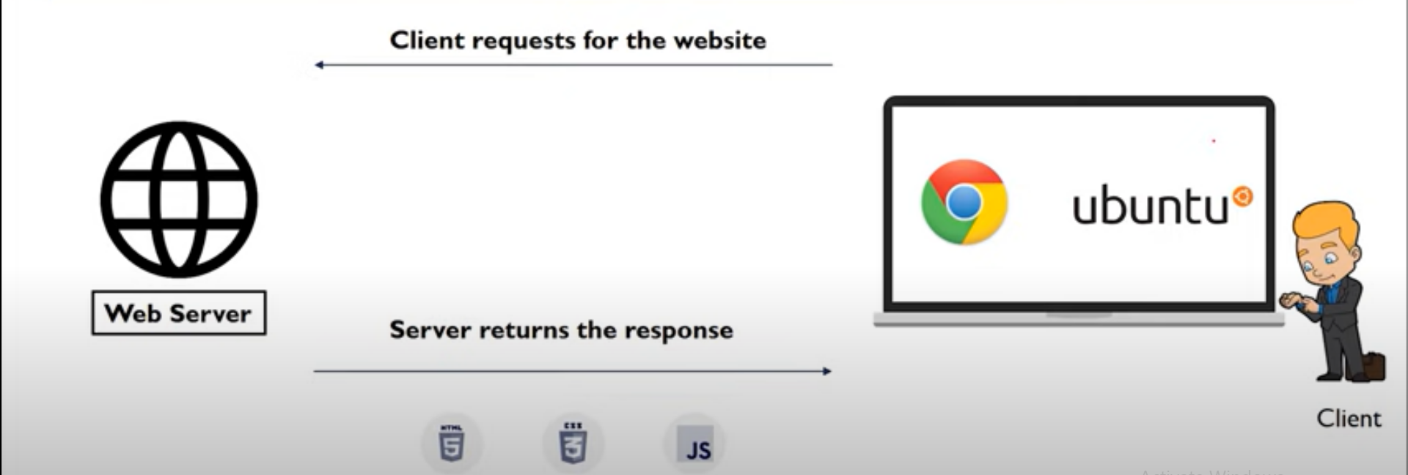

Slide 3
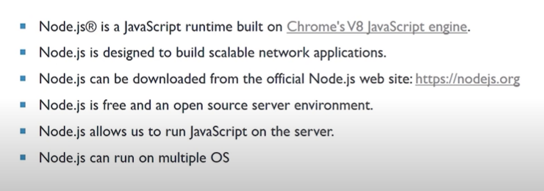

Slide 4
By default node js Code
const http = require('http');
const hostname = '127.0.0.1';
const port = 3000;
const server = http.createServer((req, res) => {
res.statusCode = 200;
res.setHeader('Content-Type', 'text/plain');
res.end('Hello World');
});
server.listen(port, hostname, () => {
console.log(`Server running at http://${hostname}:${port}/`);
});

Slide 5
const http = require('http');
const fs = require('fs');
Now we will write the line of code to read a file as follows-
const fileContent = fs.readFileSync('file name.html')
The final step is to make the server and serve the file. The code for the following is as follows-
const server = http.createServer((req, res)=>{
res.writeHead(200, {‘Content-type’ : ‘text/html’});
res.end(fileContent)
Till now we have made the server and now we will make this server listen on its port. Suppose we want to make it listen to port 80, so the code for this goes as follows-
server.listen(80, ‘127.0.0.1’, () => {
console.log(“Listening on port 80”);
});

Slide 6
The reason for listening to the server at port 80 was, we do not have to explicitly write anything else in the URL. For example, if we have taken 8000, then we have to explicitly write it on the URL to get the request back.

Slide 7
By default code
const http = require('http');
const hostname = '127.0.0.1';
const port = 3000;
const server = http.createServer((req, res) => {
res.statusCode = 200;
res.setHeader('Content-Type', 'text/plain');
res.end('Hello World');
});
server.listen(port, hostname, () => {
console.log(`Server running at http://${hostname}:${port}/`);
});

Slide 8
Mongo DB

Slide 9
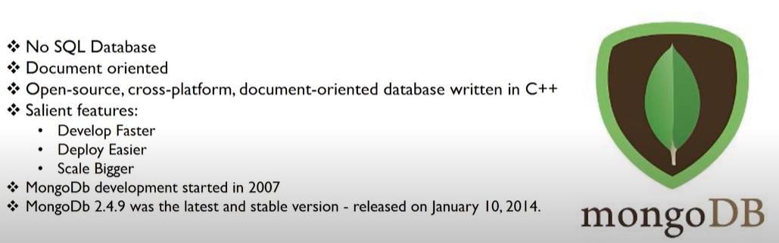
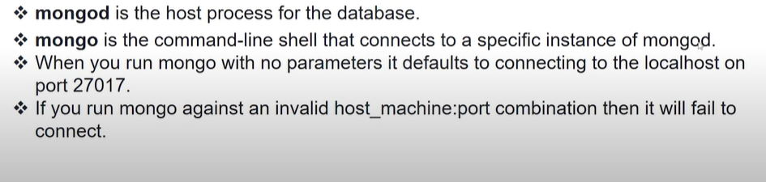
Mongo DB

Slide 10
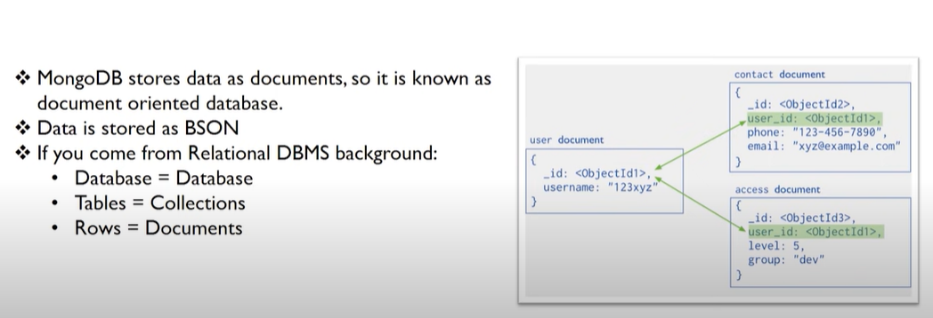
Documented Oriented Database

Slide 11
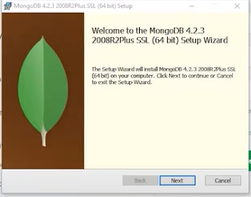
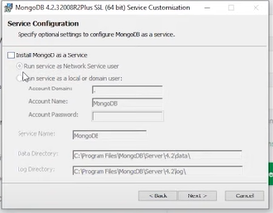
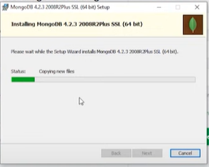
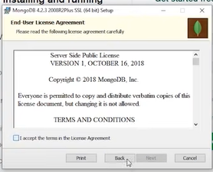
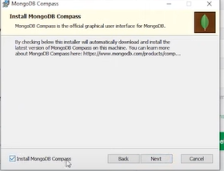
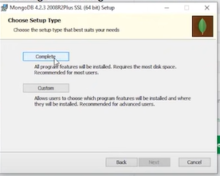
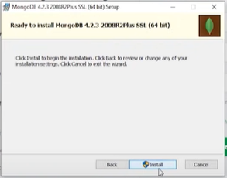
Installation process
1
4
7
Create folder at c drive with name of data
Create folder inside the data folder with name of db
2
5
8
Goto program files folder at c drive
Goto Mongodb folder
Goto server folder
Goto 4.5
Goto bin
Copy this Path/ URL
9
3
6

Slide 12
Right click on This PC
Goto properties
Select Advance System setting
Select Enviroment variable button
Click Path
Click Edit button
Clicd New button than copy that URL/ Path
Click on Ok Ok OK
10
11
Right click on Window start button
Click Window Power shell (Admin)
Write following commands
mongo + enter
mongod + enter
open another Window Power shell (Admin)
Write following commands
mongo + enter
db + enter (it has test db bydefault)
use sana (it create ur db)
show dbs + enter (this time your created db not visible untill unless you will not create any document in ur db)
Show collections (this will not return any thing)
sana.text (to create table in ur db)
db.text.insert({“name”: “sana”}) (to insert row / document in ur db)
show dbs (now ur db visible in list )
show collection (now ur table will be visible)

Slide 13
db.items.insertOne({name: "Samsung 30s", price: 22000, rating: 4.5, qty: 233, sold: 98}) (To insert single row into db)
db.items.insertMany([{name: "Samsung 30s", price: 22000, rating: 4.5, qty: 233, sold: 98}, {name: "Moto 30s", price: 29000, rating: 3.5, qty: 133, sold: 598}, {name: "Realme 80s", price: 129000, rating: 2.5, qty: 633, sold: 98, isBig: true}]) (To insert multiple row into db)
db.items.find() (To see the whole list of documents written by us.The data stored in the data directory will never get deleted until you do it manually. )

